Slide 1

Eco-Resilient Networks Smart Deployment for the Future
Activity 3: (SCRUM) Check-in # 2
Muhammad Hamza Shahab
Syed Haider Abbas Naqvi
10th March 2025
Researching and Engineering Community Centred Software
Notes:
Brief intro - "Good morning, we're presenting our progress on the Eco-Resilient Networks project."

Slide 2


Connection with Course Concepts
Digital Habitats:
Our simulation is a tool within the digital habitat of network engineers, supporting their practice.
Community Orientations:
The Tradeoff-Aware embedding policy allows for flexibility, catering to different community orientations.
Technology & Community:
We're balancing reification (network optimization) with participation (data for decisions), adding sustainability.
Technology Stewardship:
We're acting as technology stewards by creating a useful, usable, and aligned tool.
Knowledge Management:
Our simulation generates knowledge from data, aiding decision-making.
Notes:
We identified key gaps in the current technology: a lack of focus on sustainability and limited optimization capabilities.

Slide 3
Project Progress
Section | Status | Notes
MVP 2: Algorithm Implementation & Evaluation | On Track | Significant progress made on embedding policies, optimization, and performance evaluation.
Work Package 2.1: Embedding Policy Implementation | ✅ Completed | Implemented Availability-Aware, Carbon-Aware, and Tradeoff-Aware policies.
Work Package 2.2: Redundancy Optimization (PSO) | ✅ Completed | Integrated PSO with embedding policies.
Work Package 2.3: Performance Metric Calculation | ✅ Completed | Implemented availability, carbon footprint, and latency calculations.
Work Package 2.4: Algorithm Comparison & Evaluation | 🟡 In Progress | Preliminary simulations conducted; extensive comparisons planned.
Work Package 2.5: Other Optimization Algorithms (SA & GA) | 🔜 Upcoming | Implementation planned for next sprint.
MVP 3: Documentation & Reporting | Ongoing | Documentation, user guide, and research paper drafting in progress.
Work Package 3.1: Code Documentation | 🟡 In Progress | Docstrings and comments being updated.
Work Package 3.2: User Guide | 🟡 In Progress | User Guide Draft is in progress.

Slide 4
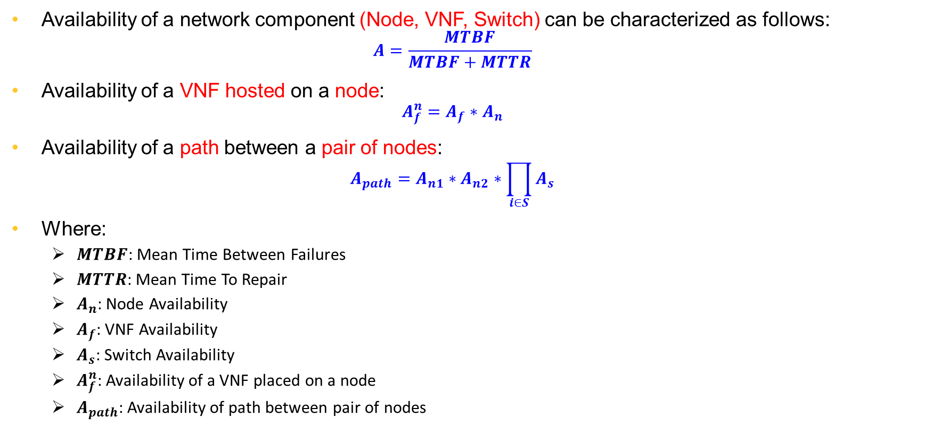
Availability Model
Availability of a network component (Node, VNF, Switch) can be characterized as follows:
$$A=\frac{MTBF}{MTBF+MTTR}$$
Availability of a VNF hosted on a node:
$$A_{f}^{n}=A_{f}∗A_{n}$$
Availability of a path between a pair of nodes:
$$A_{path}=A_{n1}∗A_{n2}∗\prod_{i∈S}{A_{s}}$$
Where:
$MTBF$: Mean Time Between Failures
$MTTR$: Mean Time To Repair
$A_{n}$: Node Availability
$A_{f}$: VNF Availability
$A_{s}$: Switch Availability
$A_{f}^{n}$: Availability of a VNF placed on a node
$A_{path}$: Availability of path between pair of nodes

Slide 5
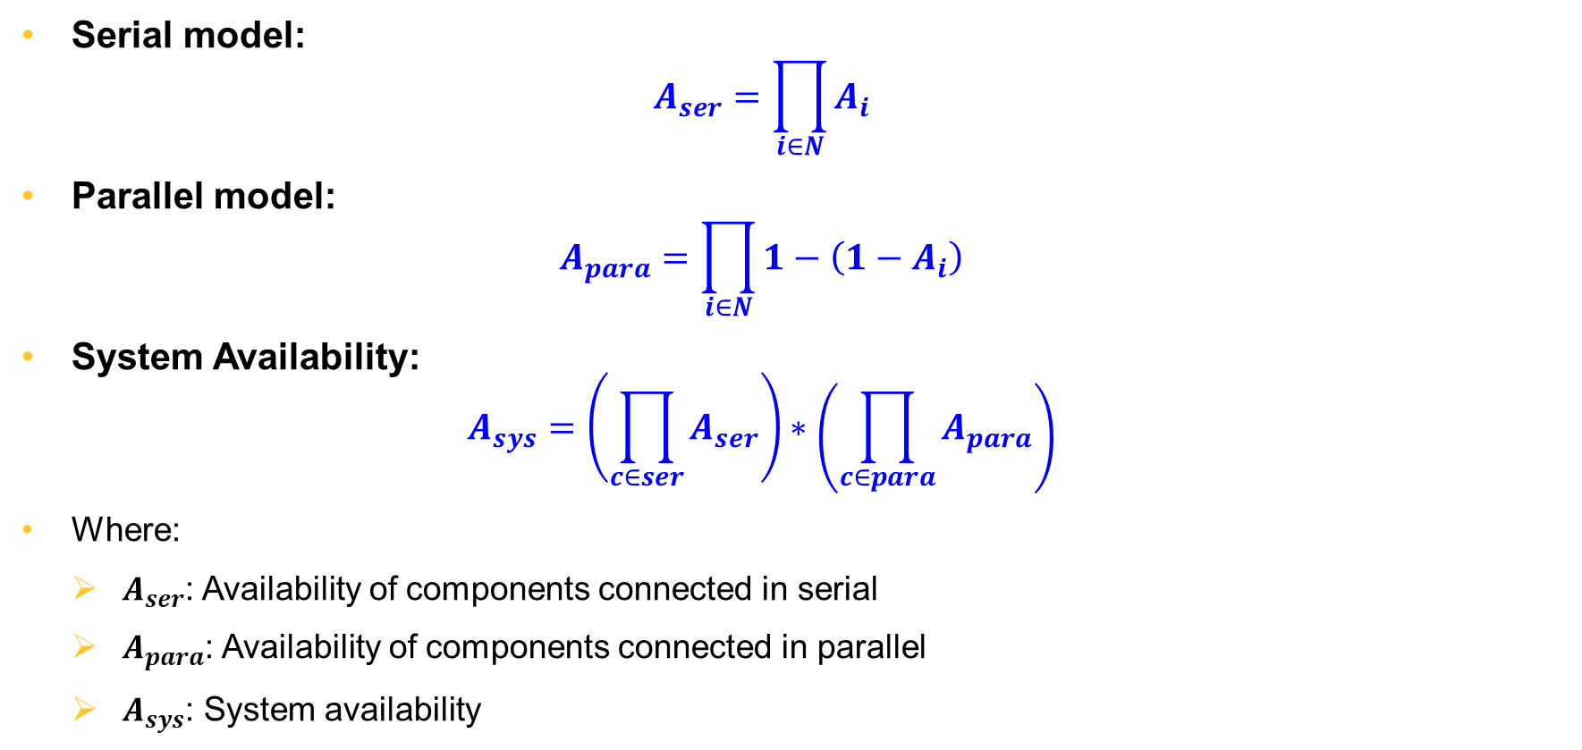
Availability Model (Cont.)
Serial model:
$$A_{ser}=\prod_{i∈N}{A_{i}}$$
Parallel model:
$$A_{para}=\prod_{i∈N}{1−\left(1−A_{i}\right)}$$
System Availability:
$$A_{sys}=\left(\prod_{c∈ser}{A_{ser}}\right)∗\left(\prod_{c∈para}{A_{para}}\right)$$
Where:
$A_{ser}$: Availability of components connected in serial
$A_{para}$: Availability of components connected in parallel
$A_{sys}$: System availability

Slide 6
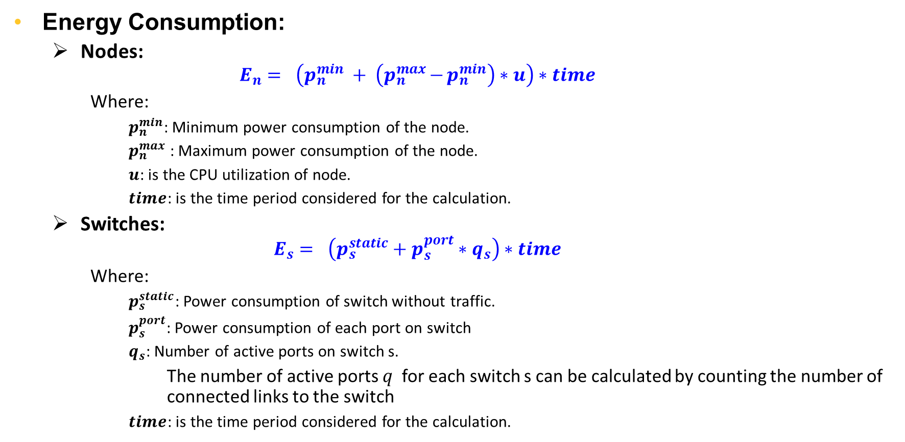
Carbon Footprint Model
Energy Consumption:
Nodes:
$$E_{n}= \left(p_{n}^{min} + \left(p_{n}^{max}{−}p_{n}^{min}\right)∗u\right)∗time$$
Where:
$p_{n}^{min}$: Minimum power consumption of the node.
$p_{n}^{max}$: Maximum power consumption of the node.
$u$: is the CPU utilization of node.
$time$: is the time period considered for the calculation.
Switches:
$$E_{s}= \left(p_{s}^{static}+p_{s}^{port}∗q_{s}\right)∗time$$
Where:
$p_{s}^{static}$: Power consumption of switch without traffic.
$p_{s}^{port}$: Power consumption of each port on switch
$q_{s}$: Number of active ports on switch s.
The number of active ports 𝑞​ for each switch s can be calculated by counting the number of connected links to the switch
$time$: is the time period considered for the calculation.

Slide 7
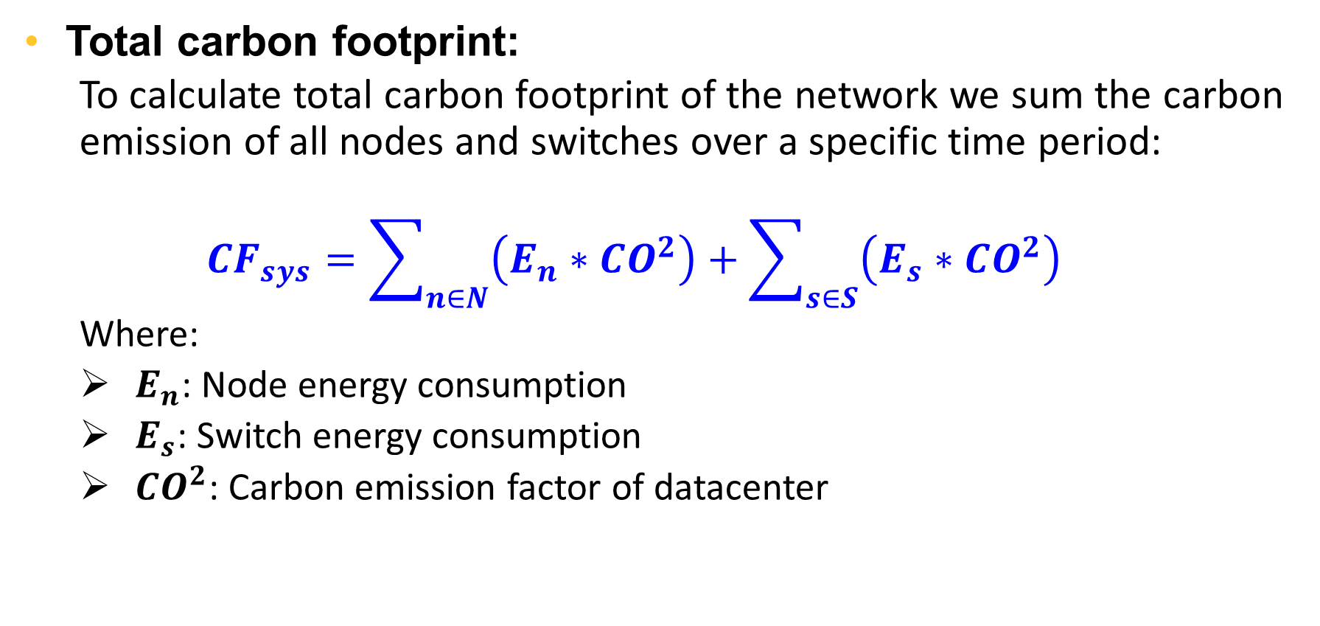
Carbon Footprint Model (cont.)
Total carbon footprint:
To calculate total carbon footprint of the network we sum the carbon emission of all nodes and switches over a specific time period:
$${CF}_{sys}=\sum_{n∈N}{\left(E_{n}∗CO^{2}\right)}+\sum_{s∈S}{\left(E_{s}∗CO^{2}\right)}$$
Where:
$E_{n}$: Node energy consumption
$E_{s}$: Switch energy consumption
$CO^{2}$: Carbon emission factor of datacenter

Slide 8
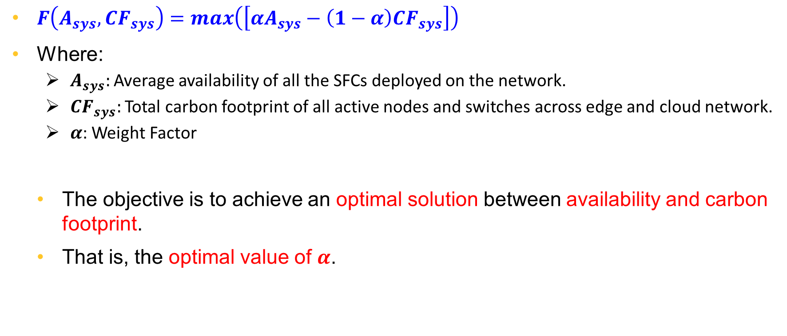
Objective Function
$F\left(A_{sys}, CF_{sys}\right)=max\left(\left[αA_{sys}−\left(1−α\right)CF_{sys}\right]\right)$
Where:
$A_{sys}:$ Average availability of all the SFCs deployed on the network.
$CF_{sys}:$ Total carbon footprint of all active nodes and switches across edge and cloud network.
𝜶: Weight Factor
The objective is to achieve an optimal solution between availability and carbon footprint.
That is, the optimal value of $α$.

Slide 9
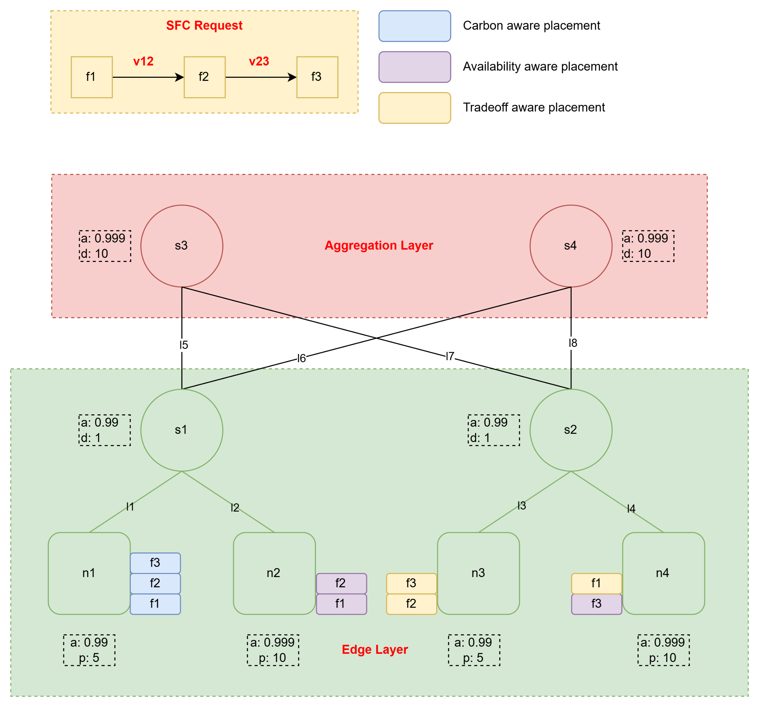
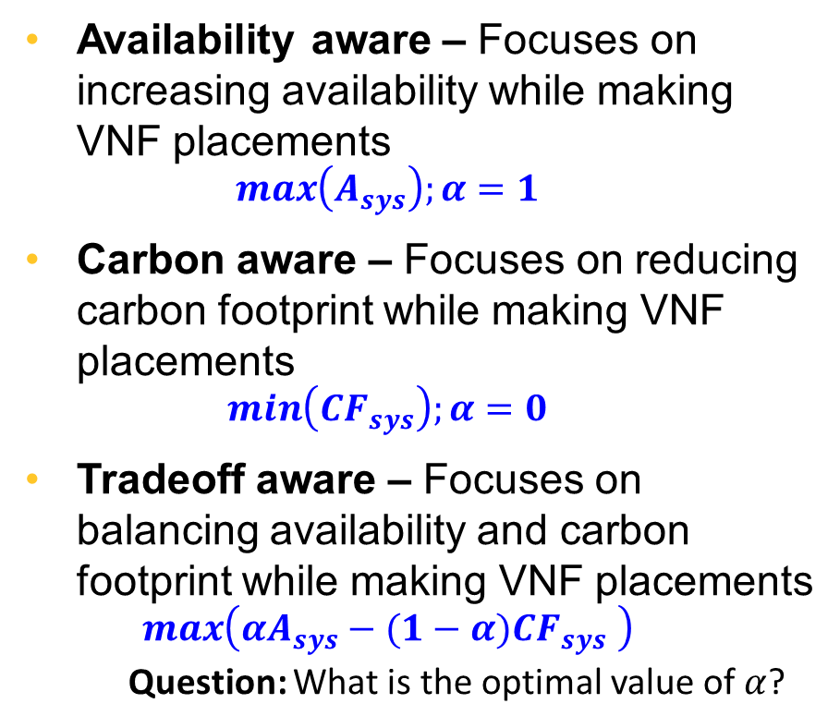
Network Placement Schemes
Availability aware – Focuses on increasing availability while making VNF placements
$$\max\left(A_{sys}\right);α=1$$
Carbon aware – Focuses on reducing carbon footprint while making VNF placements
$$\min\left({CF}_{sys}\right);α=0$$
Tradeoff aware – Focuses on balancing availability and carbon footprint while making VNF placements
$$\max\left(αA_{sys}−(1−α)CF_{sys} \right)$$
Question: What is the optimal value of $α$?

Slide 10

Preliminary Results
The availability and carbon footprint values are plotted against the different values of $α \left(weight\right)$
It is observed that the optimal balance between availability and carbon footprint is achieved at approximately:
$$α=0.4$$

Slide 11
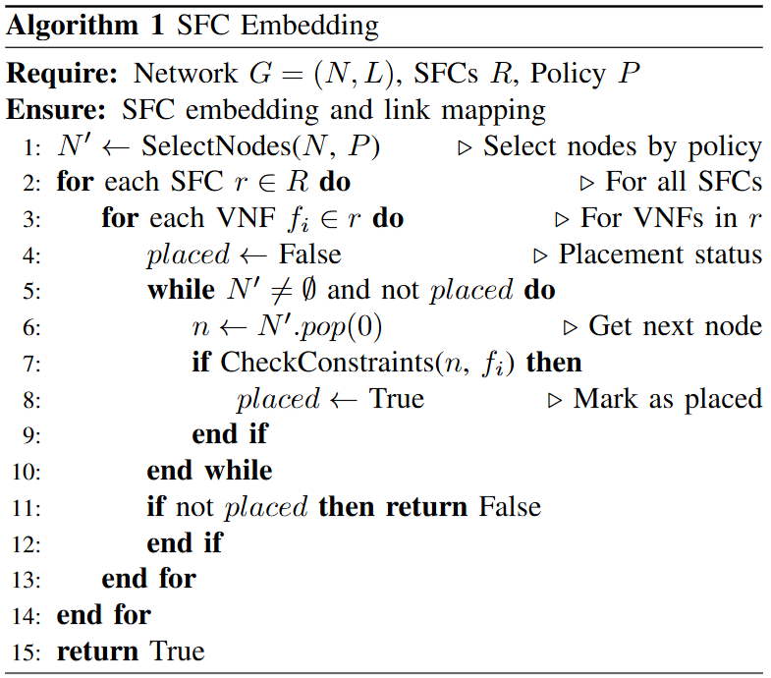
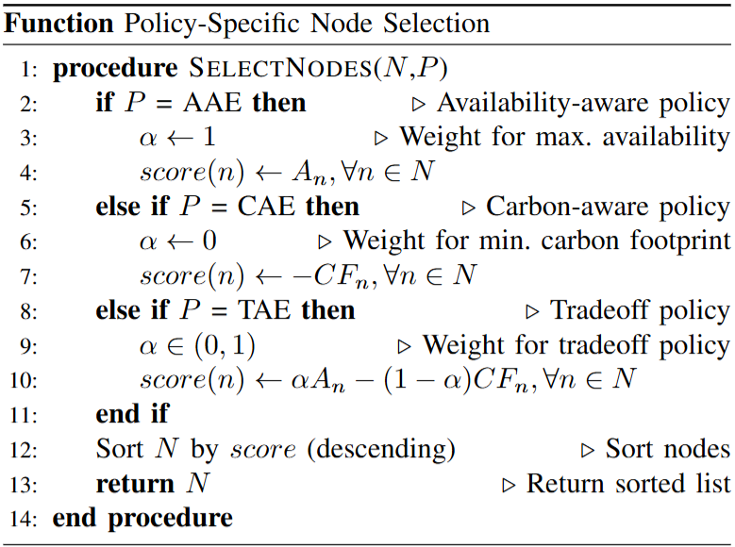
Network Placement Algorithms

Slide 12
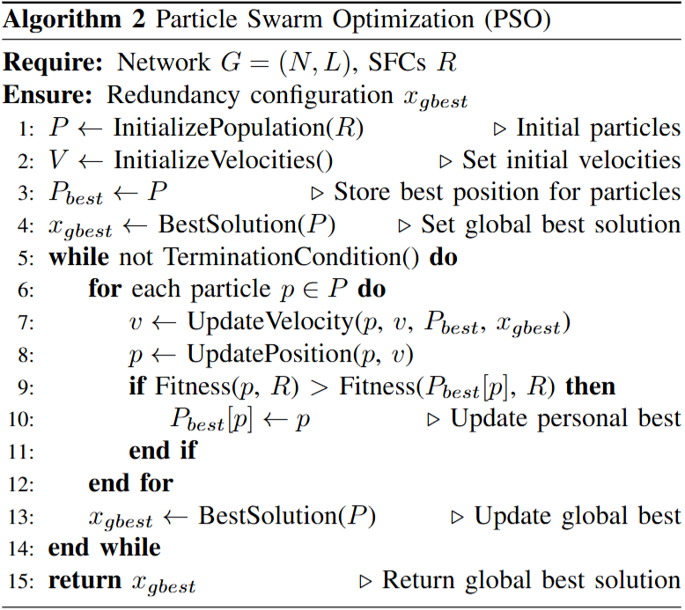
Network Allocation Algorithm (PSO)

Slide 13
Paper Writing Progress
Section | Status | Notes
Abstract | ✅ Done | Final metrics to be added
Introduction | ✅ Done | Completed
Related Works | ✅ Done | Completed
Problem Formulation | ✅ Done | Completed
Methodology | ✅ Done | Completed
Results & Analysis | ❌ Not Started | Expected till next scrum
Conclusion | ❌ Not Started | Expected till next scrum

Slide 14
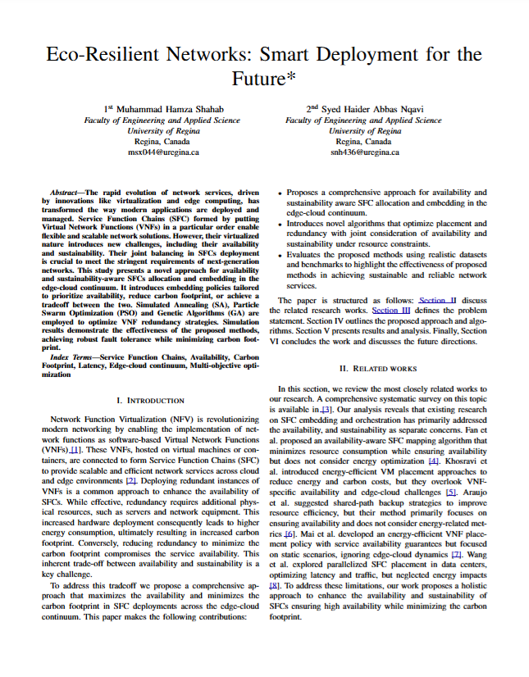
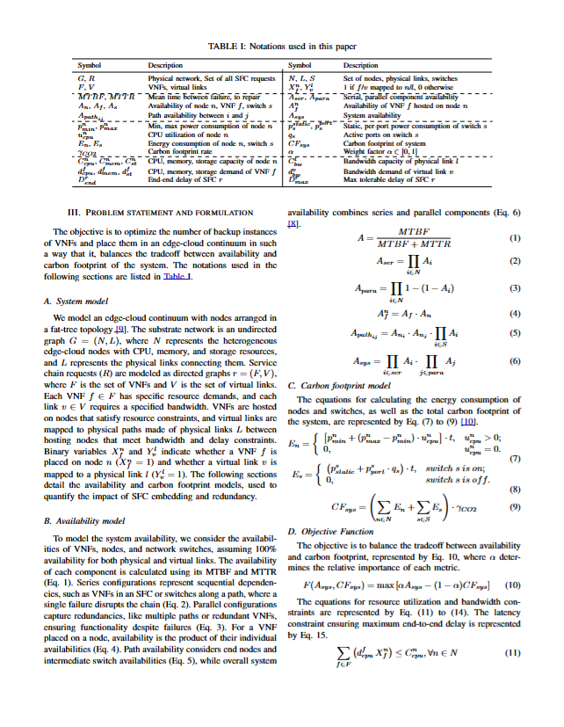
Notes:
Our project addresses the need for both reliable and sustainable networks. We're focusing on SaskTel as our primary user community.

Slide 15
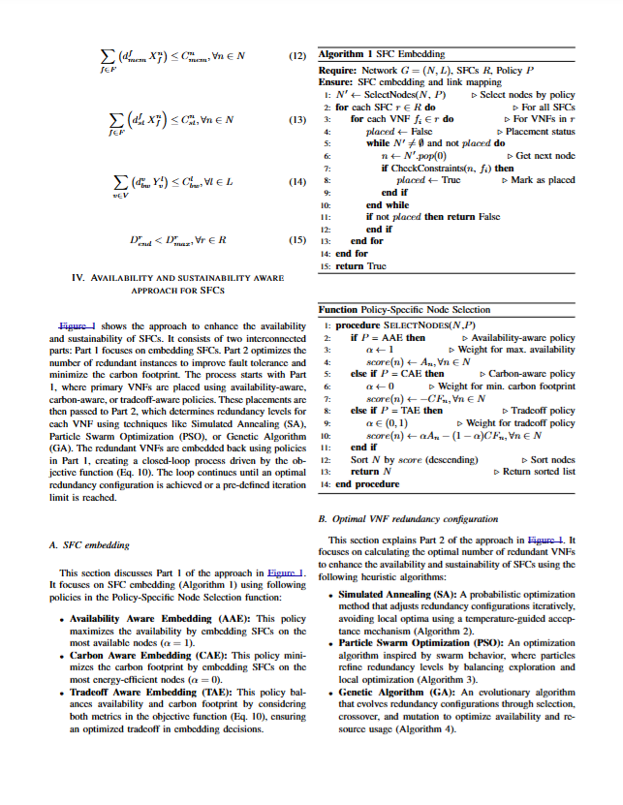
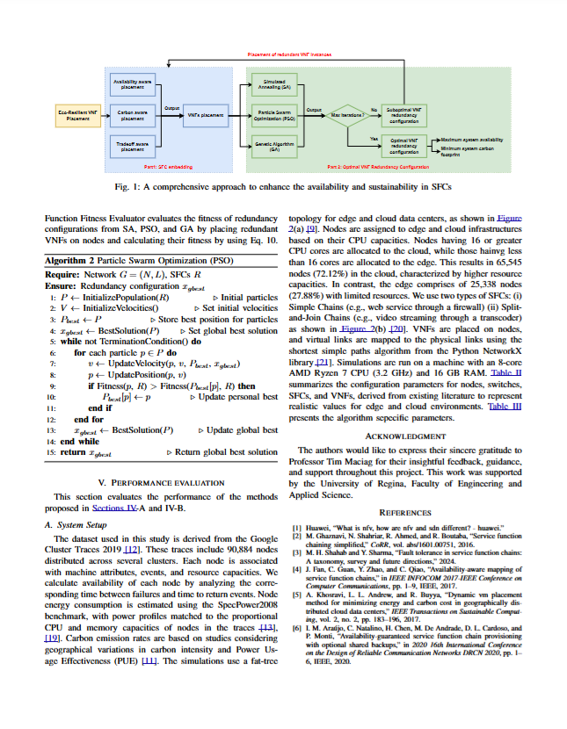
Notes:
Our project addresses the need for both reliable and sustainable networks. We're focusing on SaskTel as our primary user community.

Slide 16


Thank You - Let’s Build Sustainable Networks!
Project Link: https://github.com/hamzashahab1610/ENSE-805-Project-Eco-Resilient-Networks.git
Contact:
Email: msx044@uregina.ca
LinkedIn: https://www.linkedin.com/in/hamzashahab1610/
GitHub: https://github.com/hamzashahab1610

